Slide 1
Medical Store Management System Project
System Oriented Analysis and Design
Presented by ABDULLAH SORATHIA

Slide 2
Problem Definition
At present Medical Stores maintain their day to day transactions manually. These shops have thousands of products, they need to track of all these products to check the stock, expiry date etc.
To find the product is also another risky job, so proper system is required. They need full pledged software to overcome these problems. Apart from this regular update on stock this software also provides supplier wise cash transaction, daily sales report, etc.
This project “Medical Store Management System” is a solution to take the orders from its customers who are locally distributed. This new system not only takes the orders but it also provides facilities such as overall administration as well as the report generation for the firm. Medical Store Management System is very helpful to manage sales information of Medical Store.
It can easily keep the record of Hospitals who does regular business deals.

Slide 3
SYSTEM REQUIREMENT
Requirement of Our system is divided in to two parts:
Functional Requirement
User Interface
Maintaining Stock Availability
Maintain Records of Customer, Supplier, Bill, etc.
Update Stock
Generate Report
Non-Functional Requirement
Look and Feel
Performance
Usability
Operational
Maintainability & Portability
Legal

Slide 4
Feasibility analysis
The feasibility study is an evaluation and analysis of the potential of a proposed project which is based on extensive investigation and research to support the process of decision making
Feasibility Study is categorized into 3 types
Types of Feasibility Study
Technical Feasibility
Organizational Feasibility
Economic Feasibility

Slide 5
Technical Feasibility
The technical feasibility assessment is focused on gaining an understanding of the present technical resources of the organization and their applicability to the expected needs of the proposed system. It is an evaluation of the hardware and software and how it meets the need of the proposed system
This System is Feasible Technically
Medium Risk is Involved in term of familiarity with the technology
The Marketing Department has little experience with the sale of this type of product.

Slide 6
Organizational Feasibility
“If we build it, will they come?”
Organizational Feasibility means to understand how well the goal of the project aligns with business.
It involves Conduction of Stake holder analysis
Champion
Who initiates the project
Organizational management
Funds the project
Users
Who use the project and influences

Slide 7
Economic Feasibility
The purpose of the economic feasibility assessment is to determine the positive economic benefits to the organization that the proposed system will provide. It includes quantification and identification of all the benefits expected. This assessment typically involves a cost/ benefits analysis.
Economic Feasibility of this system was done with a conservative approach which results in a good chance of a bottom line of the company with
ROI(return on Investment) over 3 year span is 133.45%
Total Benefits over 3 year is 1.3 Million (P.V. 11,872,72)
Break Even Point after 0.439 years

Slide 8
Economic Feasibility Costing Report (Benefits)
 | Year 0 | Year 1 | Year 2 | Total
Benefits
Increased Sales |  | 5,00,000 | 5,30,000
Reduced Customer Complaints |  | 70,000 | 70,000
Reduced Inventory Cost |  | 68,000 | 68,000
Total Benefits | 0 | 6,38,000 | 6,68,000 | 1,30,600

Slide 9
Economic Feasibility Costing Report (Costs)
 | Year 0 | Year 1 | Year 2 | Total
Cost
Server | 50,000
Printers | 1,00,000
Software | 34,825
Total Development Cost | 1,84,825 |  |  | 1,84,825
Operational Cost |  | 50,000 |  | 50000
Hardware |  | 20,000 | 50,000 | 70000
Software |  | 1,15,000 | 20,000 | 135000
Labor |  |  | 1,19,600 | 119600
Total Cost | 184825 | 185000 | 189600 | 559425

Slide 10
Economic Feasibility Costing Report (Final)
 | Year 0 | Year 1 | Year 2 | Total
Total Benefits | - | 6,38,000 | 6,68,000 | 13,06,000
Total Cost | 1,84,825 | 1,85,000 | 1,89,600 | 5,59,425
Net Benefits (Total Benefits- Tota Cost | (1,84,825) | 4,53,000 | 4,78,400 | 7,46,575
Cumulative Net Cash Flow | (1,84,825) | 2,68,175 | 7,46,575

Slide 11
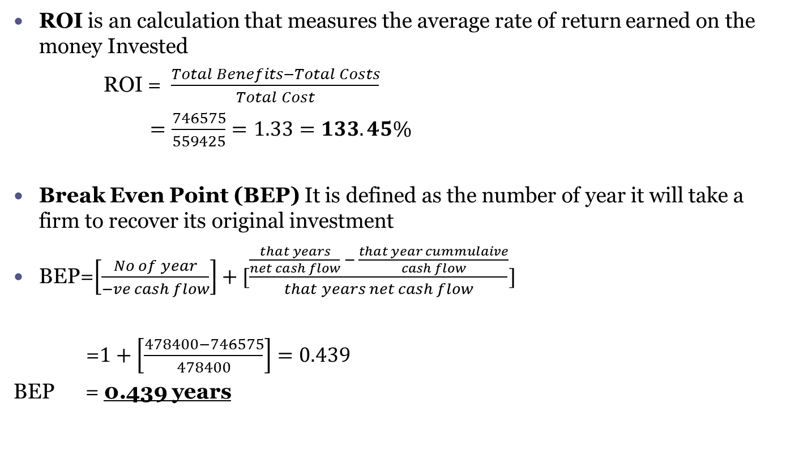
Economic Feasibility Costing Report (Final)
ROI is an calculation that measures the average rate of return earned on the money Invested
ROI = $\frac{Total Benefits−Total Costs}{Total Cost}$
$$=\frac{746575}{559425}=1.33=133.45\%$$
Break Even Point (BEP) It is defined as the number of year it will take a firm to recover its original investment
BEP=$\left[\frac{No of year}{−ve cash flow}\right]+[\frac{\frac{that years}{net cash flow} − \frac{that year cummulaive}{cash flow}}{that years net cash flow}]$
=$1+\left[\frac{478400−746575}{478400}\right]=0.439$
BEP = 0.439 years

Slide 12
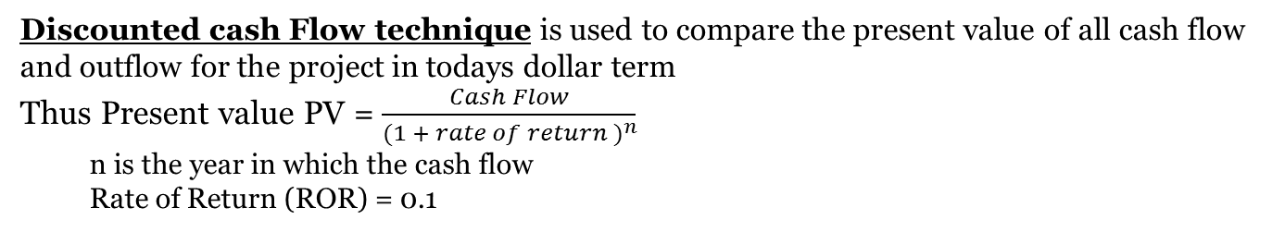
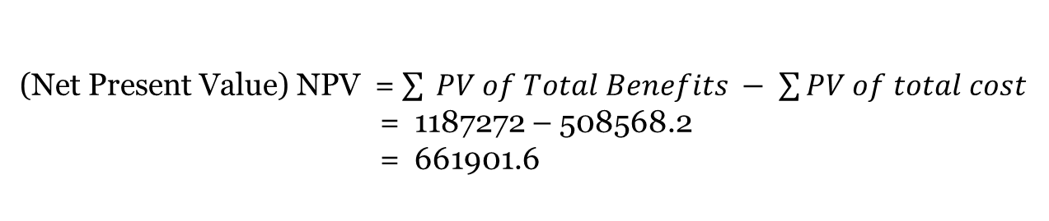
Discounted Cash Flow
Discounted cash Flow technique is used to compare the present value of all cash flow and outflow for the project in todays dollar term
Thus Present value PV = $\frac{Cash Flow}{{(1 + rate of return )}^{n}}$
n is the year in which the cash flow
Rate of Return (ROR) = 0.1
 | Year 0 | Year 1 | Year 2 | Total
Total Benefits (TB) |  | 6,38,000 | 6,68,000 | 13,06,00
PV of (TB) |  | 5,80,000 | 6,07,272 | 1,87,272
Total Cost (TC) | 1,84,825 | 1,85,000 | 1,89,600 | 5,59,425
PV OF TC | 1,84,825 | 1,68,181 | 1,72,363 | 5,25,370
(Net Present Value) NPV = $\sum{ PV of Total Benefits − \sum{PV of total cost}}$
= 1187272 – 508568.2
= 661901.6
NPV > 0 “Acceptable but are u Ready”

Slide 13
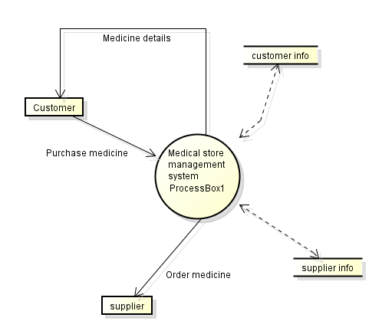
DFD (Data Flow Diagram) Context Level
Customer purchase Medicine from Medical store management, wherein he can also
purchase a number of Medicine
at a time, first select them and
then purchase it. Customer and
supplier are actors whereas
supplier info and customer info
are the data base. Customer info
will store complete information
of customer e.g. customer name,
address, mobile number etc.
whereas if any update is done
than the database is updated.
Supplier info database contains
supplier id, supplier name,
address and other supplier
details etc.

Slide 14
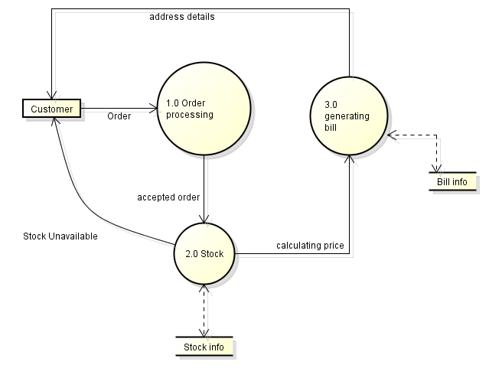
DFD (Data Flow Diagram) Level-1
Customer selects the products and order processing is done, order processing sends
the products details to
stock wherein it will check
from the database for the
availability of the stock and
informs customer about the
stock availability. if the stock
are available and the customer
is done with its purchase than
the stock will calculate the
base price and calculate the
price of all the products. The
price details are than send to
generate bill which will do
final processing and evaluation
of bill and send the bill and
delivery details to the customer.

Slide 15
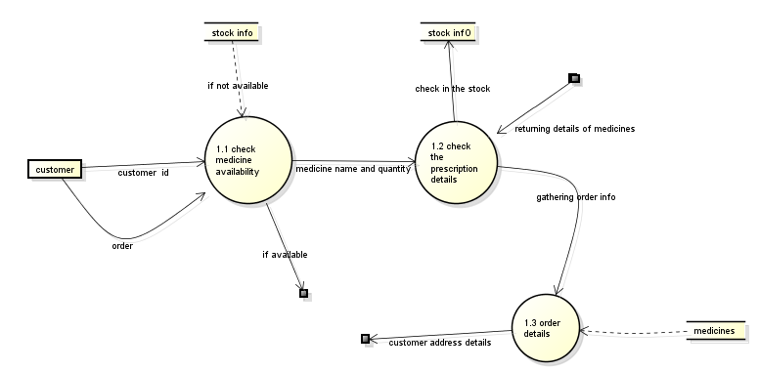
DFD (Data Flow Diagram) Level-2.1
Customer orders for the medicine , so the customer id and order details are send to
check product availability wherein he checks for the availability of the products from
the stock info database if available than it will send the product id and quantity of the
products to check the quantity which checks from the stock info database all the order
details are than
collected and
send to order
details if the
product is
unavailable
Than the signal
Is send to check
stock list so that
to order for
new stock.

Slide 16
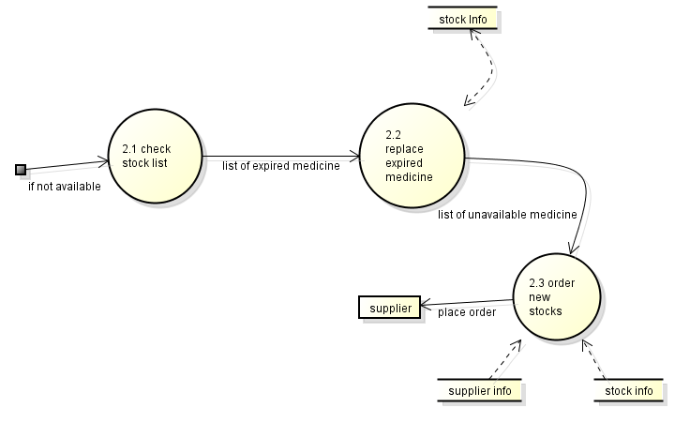
DFD (Data Flow Diagram) Level-2.2
Here in if Medicines are not available than the check stock list checks for stock details
and sends the expired goods to replace expired goods and list of unavailable of goods
are sent to order
new stock that will
order new stock
which will first
gather the supplier
info and gives the
order for new stock
and the order
placed to the
supplier.

Slide 17
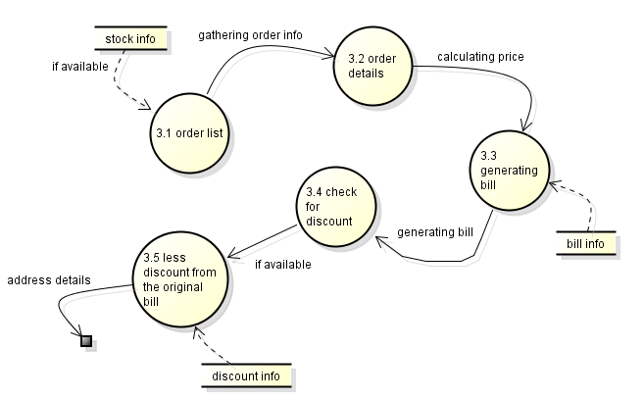
DFD (Data Flow Diagram) Level-2.3
If the medicine that are ordered by the customer are available than the ordered list
receives the list of products that are ordered by the customers. The base price is
calculated and the generate bill function now comes into picture where it gathers
information from the
bill record database and
wherein it will check for
any available discount
on the products and if
available then it is
deducted from the
generate bill and the
final bill is calculated
and the delivery details
are sent to the customer.

Slide 18
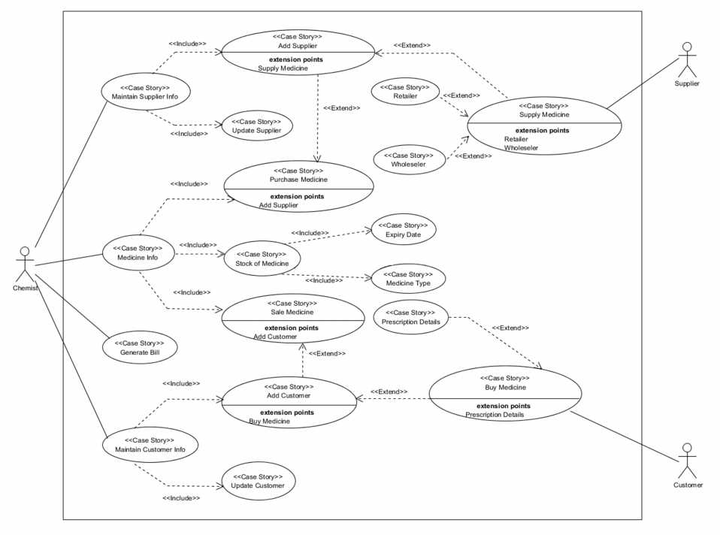
Use Case Diagram

Slide 19
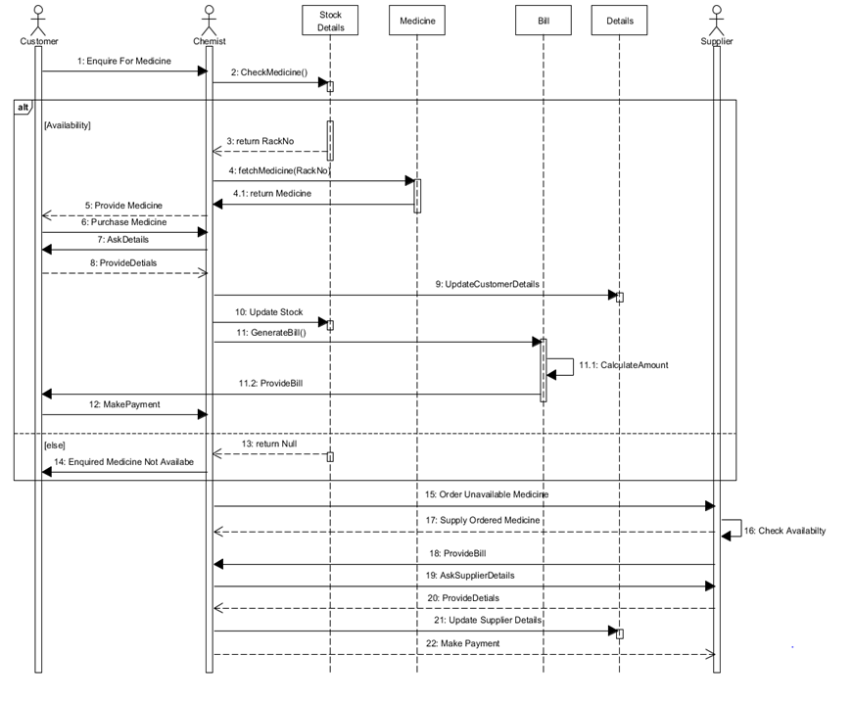
Sequence diagram Diagram

Slide 20
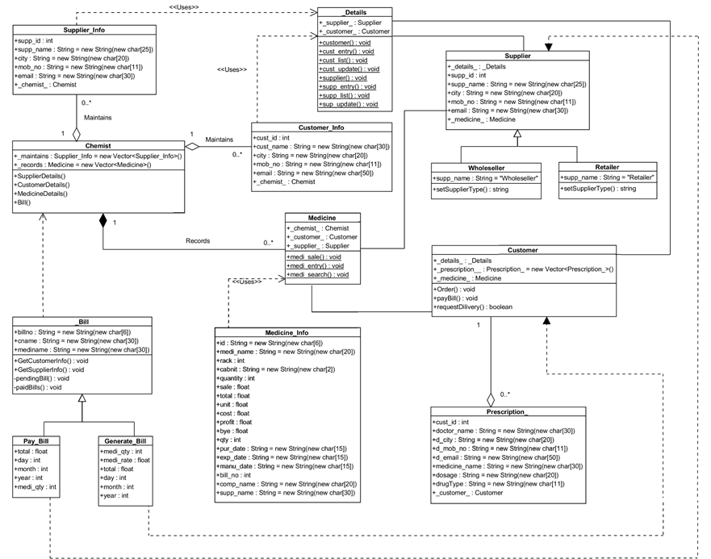
Class Diagram
1..*
1…*
1
1
1
1..*
1..*
1

Slide 21
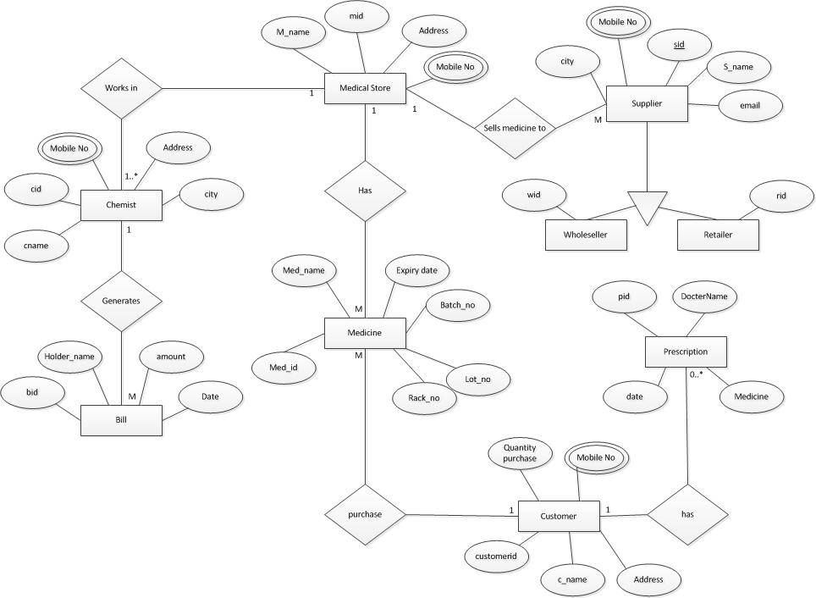
ER DIAGRAM
is

Slide 22
Architecture Designs
We can design a software by using multiple tier architecture(commonly known as N-tier architecture).
N-tier application architecture provides a model by which developers can create flexible and reusable applications.
In this, the presentation, the application processing, and the data management are logically separate processes.
The most widespread use of multi-tier architecture is the three-tier architecture.

Slide 23
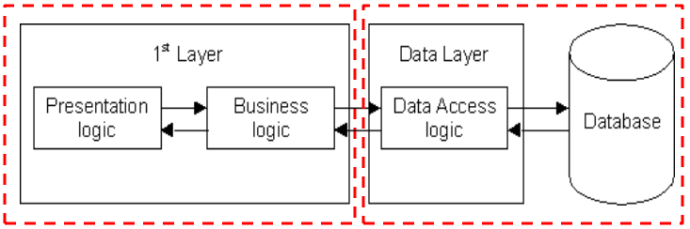
2-Tier Architecture
The two-tier architecture is like client server application. The direct communication takes place between client and server. There is no intermediate between client and server.
Here the communication is one to one.
The two tiers of two-tier architecture is
Database (Data tier)
Client Application (Client tier)
So, in client application the client writes the program for saving the record in SQL Server and thereby saving the data in the database.
Advantages: Understanding and maintenances is easier.
Disadvantages: Performance will be reduced when there are more users.

Slide 24
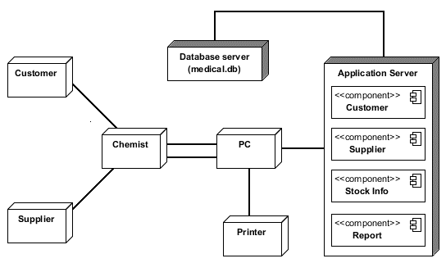
Architecture Design ( Deployment Diagram )

Slide 25
Medical Store Management Architecture
So this project “Medical Store Management System” is based on two tier architecture.
Here the two tiers are:
Client(Chemist)
Database(medical.db)
Here the client is the Chemist(owner of the software application ) who has direct access to the database.
If the chemist needs to make any changes to the database he can do it directly.

Slide 26
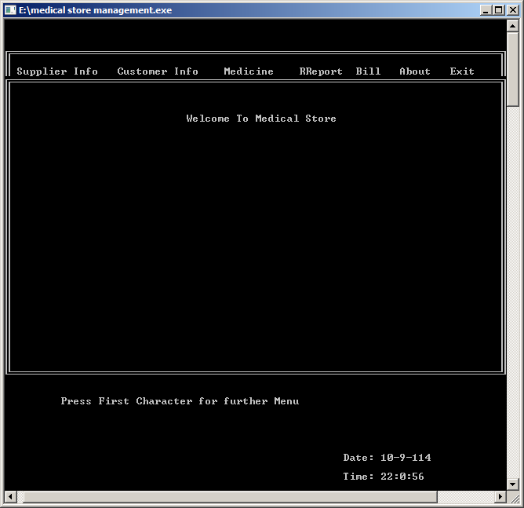
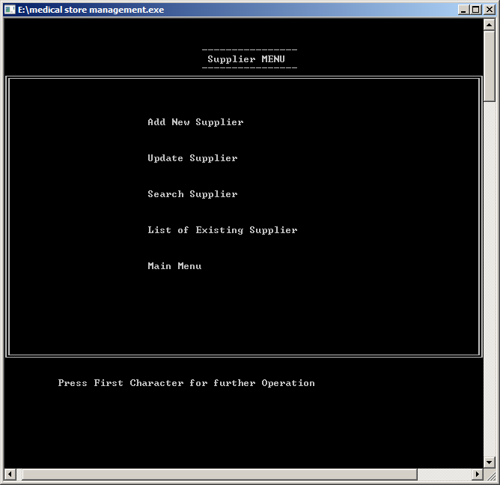
Prototype of the System
Main Menu
Supplier Info

Slide 27
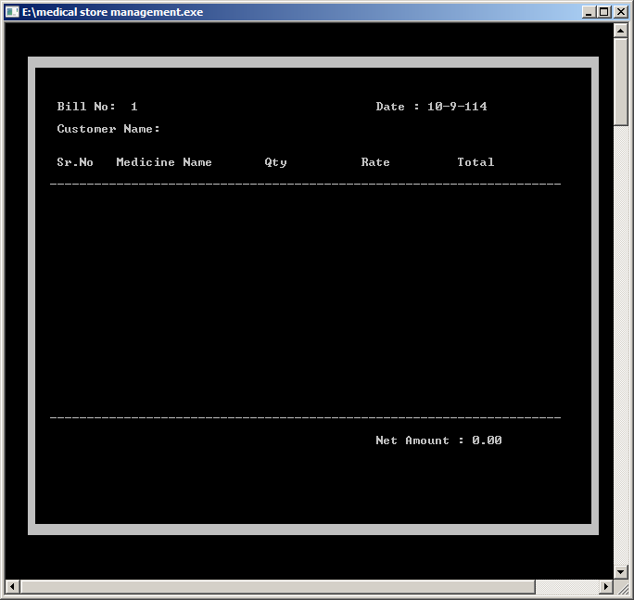
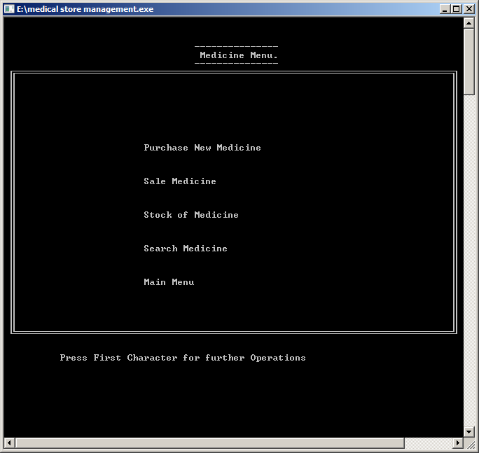
Bill Generation Interface
Medicine Inventory

Slide 28
Conclusion
Therefore we conclude that our system has
No performance variations due to increased transaction volumes.
Quick response to user query/user inputs.
Access limited only to the owner.
Flexibility to modify database as per user requirement.
Ease of maintenance.
Ability to ensure quick root-outs of enhancements upgrades.

Slide 29
Thank You

